Slide 1
Chapter-1
Integration
Indefinite Integrals
Definite Integrals

Slide 2
1.1Indefinite Integrals

Slide 3
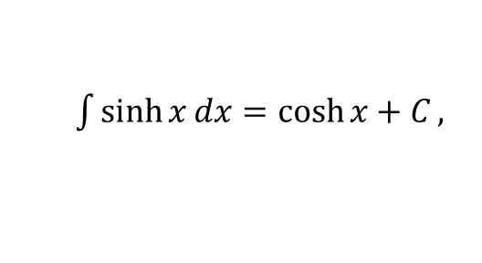



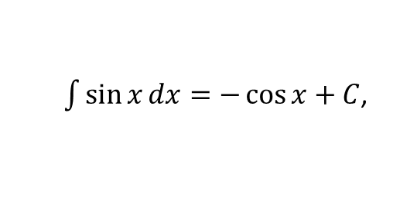

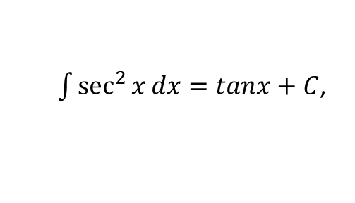

1.1.1 Definition of Indefinite Integrals
Indefinite integration may be regarded as the inverse operation to differentiation. This means that the derivative of an indefinite integral of a function is the function itself.
Given a function $f(x)$ and $F(x)$ is an anti-derivative of $f\left(x\right)$such that $F^{′}\left(x\right)=f(x)$. Then$F(x)$ is said to be indefinite integral or anti derivative of $f\left(x\right)$ ,which can be written as
Here, is called integral symbol, $f(x)$ is called integrand, $x$ is called integration variable and $C$ is called constant of integration.
Example 1.1.1
$\int{\sin{x}}dx=−\cos{x}+C$,
since $\frac{d}{dx}\left(−\cos{x}+C\right)=\sin{x}$
$\int{\sinh{x}dx=\cosh{x+C},}$
since $\frac{d}{dx}\left(\cosh{x}+C\right)=\sinh{x}$
$\int{\sec^{2}{x}}dx=tanx+C$,
since $\frac{d}{dx}\left(tanx+C\right)=\sec^{2}{x}$
$\int{x^{3}}dx=\frac{x^{4}}{4}+C$,
since $\frac{d}{dx}\left(\frac{x^{4}}{4}+C\right)=x^{3}{}$

Slide 4
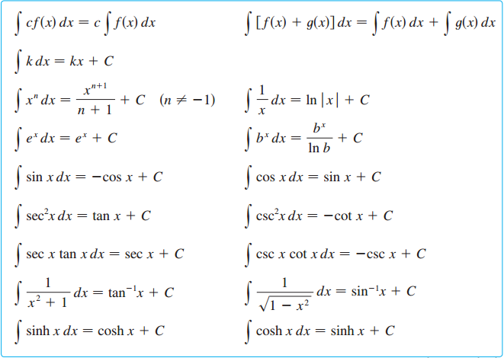
Integral properties and table of indefinite integrals
.

Slide 5
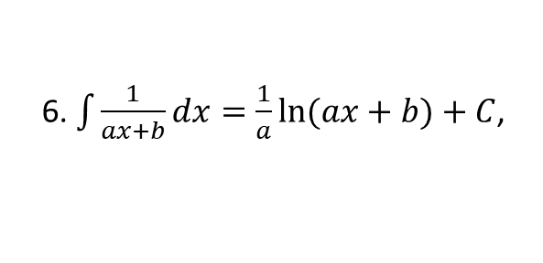
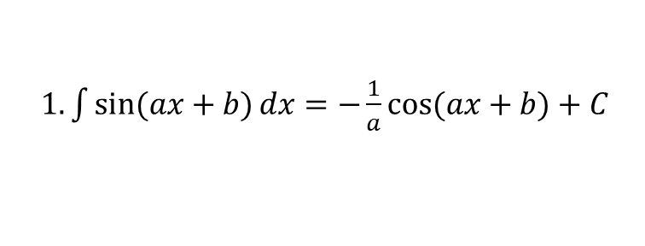

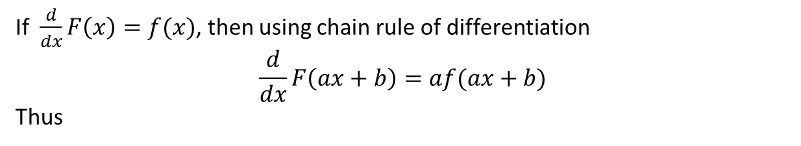
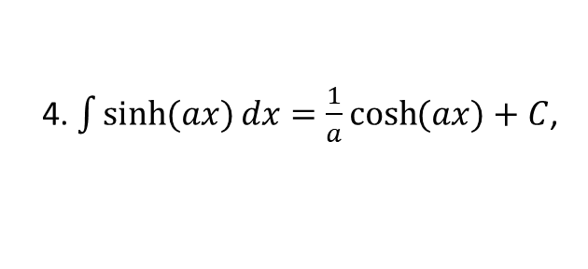
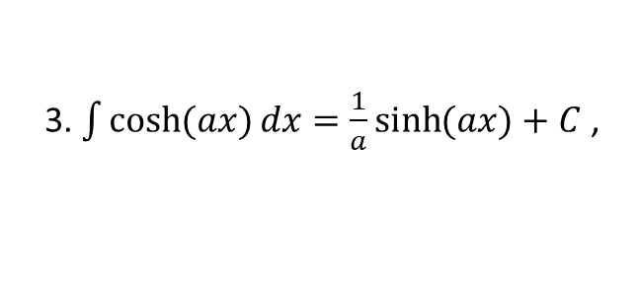
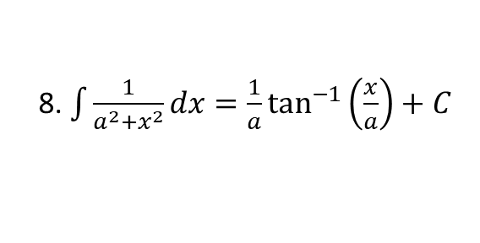
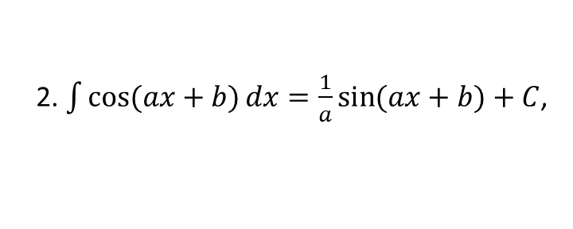
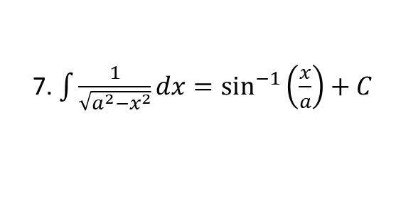
Useful Technique
If $\frac{d}{dx}F\left(x\right)=f(x)$, then using chain rule of differentiation
$$\frac{d}{dx}F\left(ax+b\right)=af(ax+b)$$
Thus
$1.\int{\sin{(ax+b)}dx}=−\frac{1}{a}\cos{(ax+b)}+C$
2. $\int{\cos{(ax+b)}dx}=\frac{1}{a}\sin{(ax+b)}+C$,
3. $\int{\cosh{(ax)}}dx=\frac{1}{a}\sinh{(ax)}+C$ ,
4. $\int{\sinh{(ax)}dx=\frac{1}{a}\cosh{(ax)}}+C$,
5. $\int{({ax+b)}^{n}}dx=\frac{{\left(ax+b\right)}^{n+1}}{\left(n+1\right)a}+C (n≠−1)$,
6. $\int{\frac{1}{ax+b}dx}=\frac{1}{a}\ln{(ax+b)}+C$,
7. $\int{\frac{1}{\sqrt{a^{2}−x^{2}}}dx}=\sin^{−1}\left(\frac{x}{a}\right)+C$
8. $\int{\frac{1}{a^{2}+x^{2}}dx}=\frac{1}{a}\tan^{−1}\left(\frac{x}{a}\right)+C$

Slide 6




Example set-1.1.1
1.
2.
3.

Slide 7




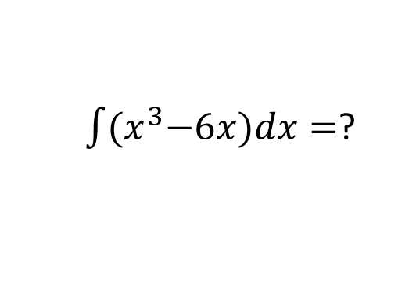
4.
$\int{\left({2x}^{3}−6x+\frac{3}{x^{2}+1}\right)dx} =$2$\int{x^{3}dx−6\int{xdx}+3\int{\frac{1}{x^{2}+1}dx}}$
5.
$=2.\frac{x^{4}}{4}−6.\frac{x^{2}}{2}+3.\tan^{−1}{x+c}$
$\int{\left(\frac{2t^{2}+t^{2}\sqrt{t}+2}{t^{2}}\right)dt} =$ 2$\int{dt+\int{t^{\frac{1}{2}}dt}+2\int{t^{−2} dt}}$
6.
$=2.t−\frac{2}{3}t^{\frac{3}{2}}.−\frac{1}{3}t^{−3}+C$
7.
$\int{{(x}^{3}−6x)dx}=$?

Slide 8
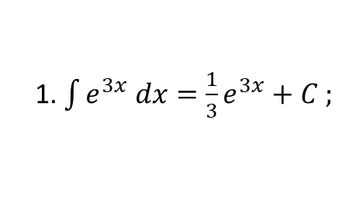

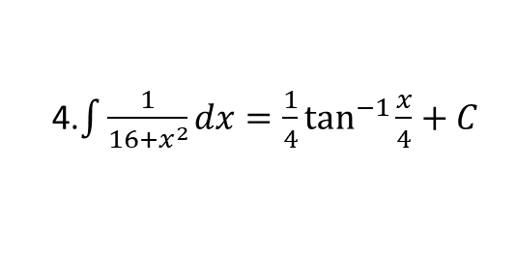
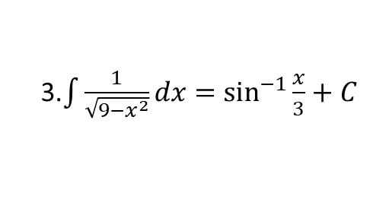
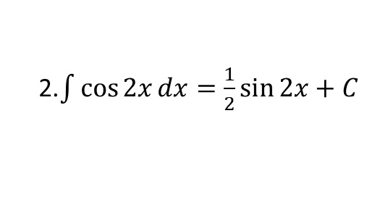
Example 1.1.2
1. $\int{e^{3x} dx}=\frac{1}{3}e^{3x}+C ;$
2.$\int{\cos{2x}}dx=\frac{1}{2}\sin{2x}+C$
3.$\int{\frac{1}{\sqrt{9−x^{2}}}dx}=\sin^{−1}{\frac{x}{3}}+C$
4.$\int{\frac{1}{16+x^{2}}dx}=\frac{1}{4}\tan^{−1}{\frac{x}{4}}+C$
5. $\int{(2x+{3)}^{3}dx=\frac{{\left(2x+3\right)}^{4}}{4×2}}+C=\frac{{\left(2x+3\right)}^{4}}{8}+C$

Slide 9
Example 1.1.2
1. $\int{e^{3x} dx}=\frac{1}{3}e^{3x}+C ;$
2.$\int{\cos{2x}}dx=\frac{1}{2}\sin{2x}+C$
3.$\int{\frac{1}{\sqrt{9−x^{2}}}dx}=\sin^{−1}{\frac{x}{3}}+C$
4.$\int{\frac{1}{16+x^{2}}dx}=\frac{1}{4}\tan^{−1}{\frac{x}{4}}+C$
5. $\int{(2x+{3)}^{3}dx=\frac{{\left(2x+3\right)}^{4}}{4×2}}+C=\frac{{\left(2x+3\right)}^{4}}{8}+C$

Slide 10
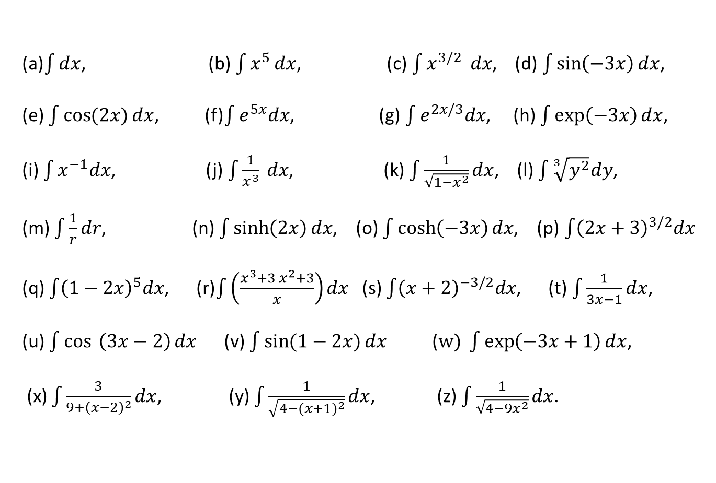
Exercise set-1.1.1
(a)$\int{dx}$, (b) $\int{x^{5 }dx}$, (c) $\int{x^{3/2 } dx}$, (d) $\int{\sin\left(−3x\right)dx}$,
(e) $\int{\cos{(2x)}dx}$, (f)$\int{e^{5x}dx}$, (g) $\int{e^{2x/3}dx}$, (h) $\int{\exp\left(−3x\right)dx}$,
(i) $\int{x^{−1}dx}$, (j) $\int{\frac{1}{x^{3}}} dx$, (k) $\int{\frac{1}{\sqrt{1−x^{2}}}dx}$, (l) $\int{\sqrt[3]{y^{2}}dy}$,
(m) $\int{\frac{1}{r}dr}$, (n) $\int{\sinh\left(2x\right)dx}$, (o) $\int{\cosh\left(−3x\right)dx}$, (p)$\int{{\left(2x+3\right)}^{3/2}dx}$
(q) $\int{{\left(1−2x\right)}^{5}dx}$, (r)$\int{\left(\frac{x^{3}+3 x^{2}+3}{x}\right)dx}$ (s) $\int{{\left(x+2\right)}^{−3/2}dx}$, (t)$\int{\frac{1}{3x−1}dx}$,
(u) $\int{\cos{ \left(3x−2\right)}dx}$ (v) $\int{\sin{(1−2x)}dx}$ ($w) \int{\exp\left(−3x+1\right)dx}$,
(x) $\int{\frac{3}{9+{\left(x−2\right)}^{2}}dx}$, (y) $\int{\frac{1}{\sqrt{4−({x+1)}^{2}}}dx}$, (z) $\int{\frac{1}{\sqrt{4−9x^{2}}}dx}$.

Slide 11
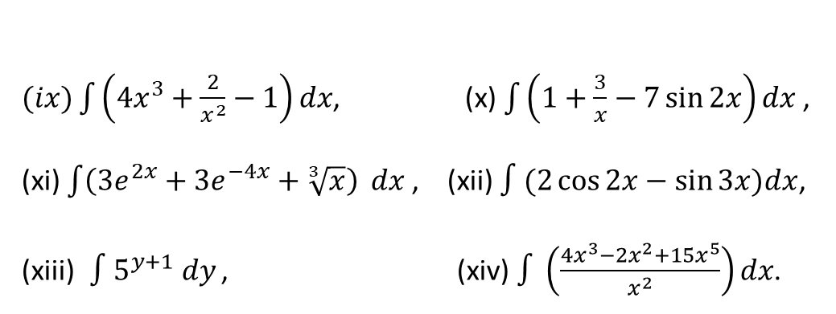
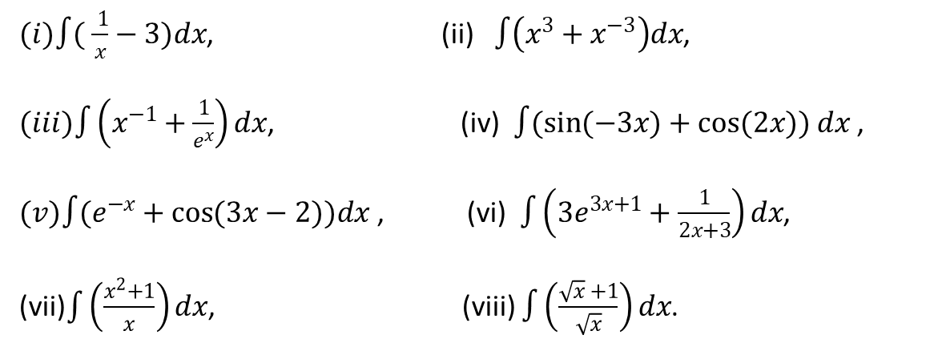
Exercise set-1.1.2
$(i)∫( \frac{ 1}{x}−3)dx$, (ii) $∫\left(x^{3}+x^{−3}\right)dx$,
$(iii)∫\left(x^{−1}+\frac{1}{e^{x}}\right)dx$, (iv)$∫(\sin{(−3x)+\cos{(2x)) dx }}$,
$(v)∫(e^{−x}+\cos{(3x−2))dx}$ , (vi) $∫\left(3e^{3x+1}+\frac{1}{2x+3}\right)dx$,
(vii)$\int{\left(\frac{x^{2}+1}{x}\right)}dx$, (viii) $∫\left(\frac{\sqrt{x} +1}{\sqrt{x}}\right)dx$.
$(ix)\int{\left(4x^{3}+\frac{2}{x^{2}}−1\right)}dx$, (x) $\int{\left(1+\frac{3}{x}−7\sin{2x}\right)dx }$,
(xi) $\int{\left(3e^{2x}+3e^{−4x}+\sqrt[3]{x}\right)} dx$, (xii) $∫(2\cos{2x−\sin{3x)dx}}$,
(xiii)$∫5^{y+1} dy$ , (xiv) $∫\left(\frac{4x^{3}−2x^{2}+15x^{5}}{x^{2}}\right)dx$.
Calculus– James Stewart - 8th edition
P-408 Ex # 5-18

